Slide 1
CAPSTONE project
CAPSTONE PROJECT
-Mahesh Shende

Slide 2
The final course of the Data Science Professional Certificate consist of a capstone project where in all the skills and relevant knowledge that one has gathered from this 9 intense courses has to be applied on a final capstone project. The final problem as well as the analysis is the left for the reader to explore and decide. The idea uses location data with the help of the foursquare api that can be leveraged into coming up with a problem that the foursquare location data to solve it or just in contrast to compare cities or neighbourhoods of ones own choice
Introduction

Slide 3
In this ever changing world of technology and reforms the use of AI will dominate and change most of the world and industries as we know so among the two busiest cities in the world which one would a person be willing to start a business in AI. Various factors would be included such as pricing, multiculturism, language barriers and so on would influence this decision.
Business Problem

Slide 4
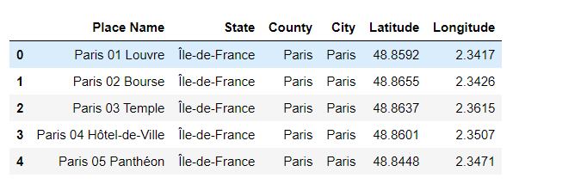
Data
Paris Dataset

Slide 5
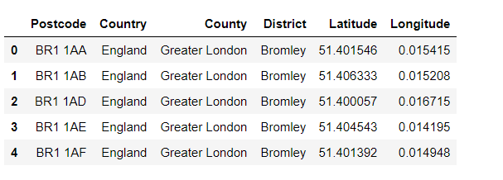
Data
London Dataset

Slide 6
An in-depth research of the dataset has been done and a thorough analysis of the various features and methods have been investigated to ensure the maximum accuracy of the model as possible. After reduction of the number of features in the data frame by replacing them with more useful data cluster analysis was done to find the best cluster of both Paris and London and then correlation and various other visual graphs were used to compare the two cities.
Methodology

Slide 7
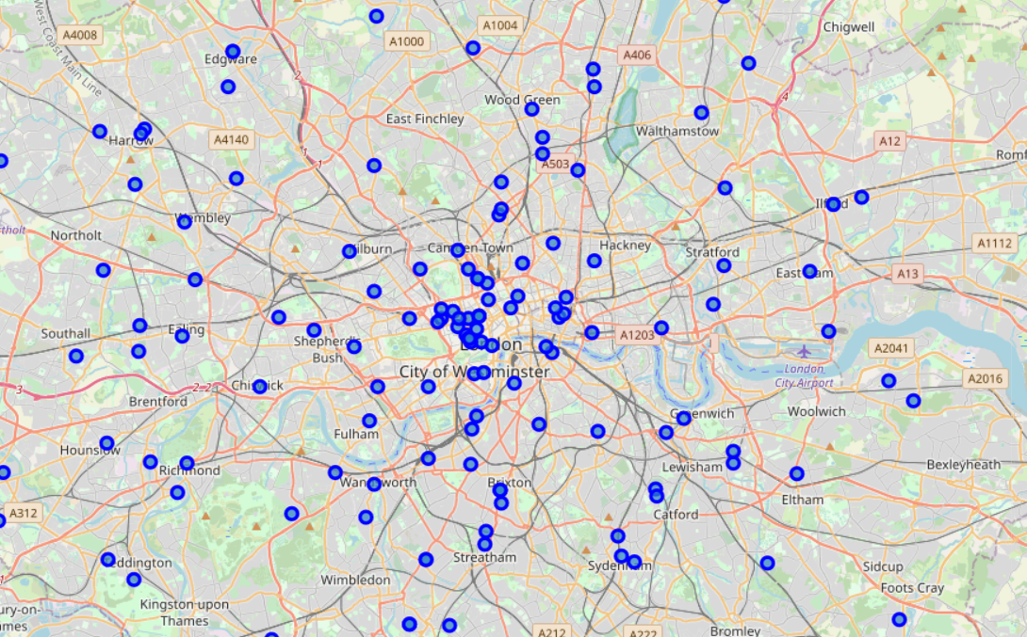
Map London

Slide 8
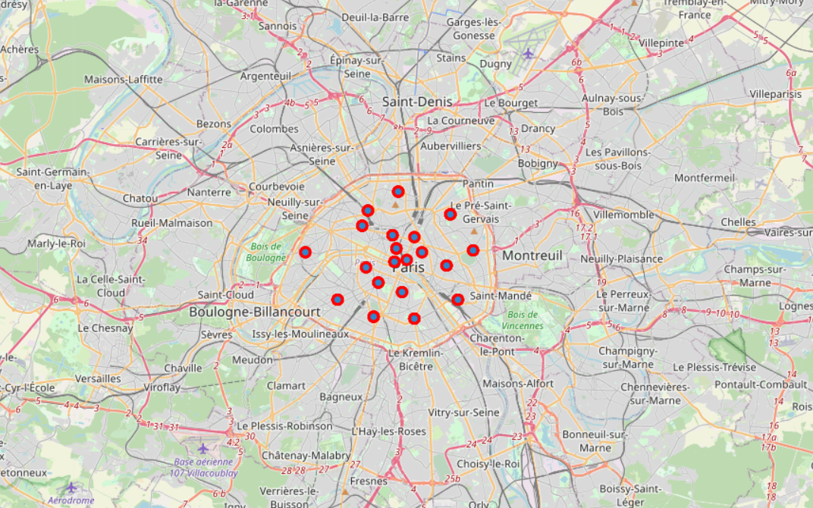
Map Paris

Slide 9
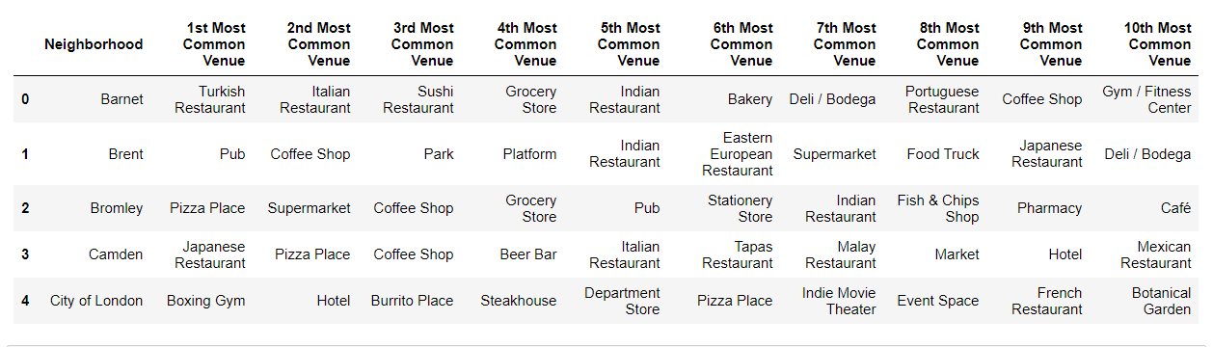
Venues
London

Slide 10
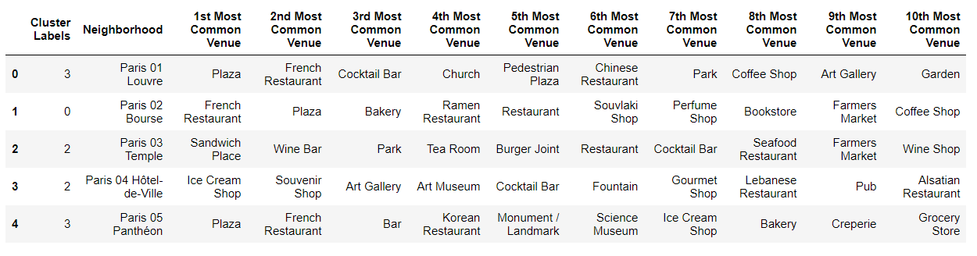
Venues
Paris

Slide 11
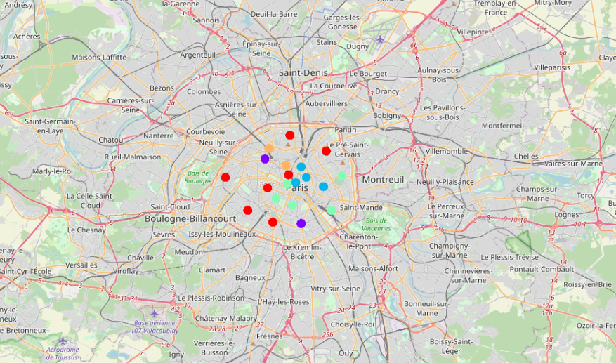
K Means Clustering Map - Paris

Slide 12
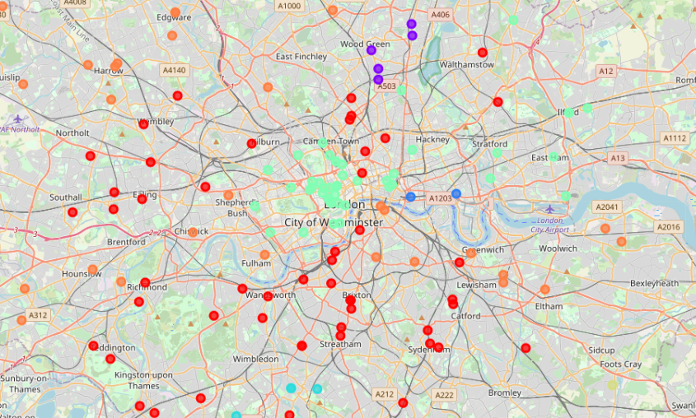
K Means Clustering Map - London

Slide 13
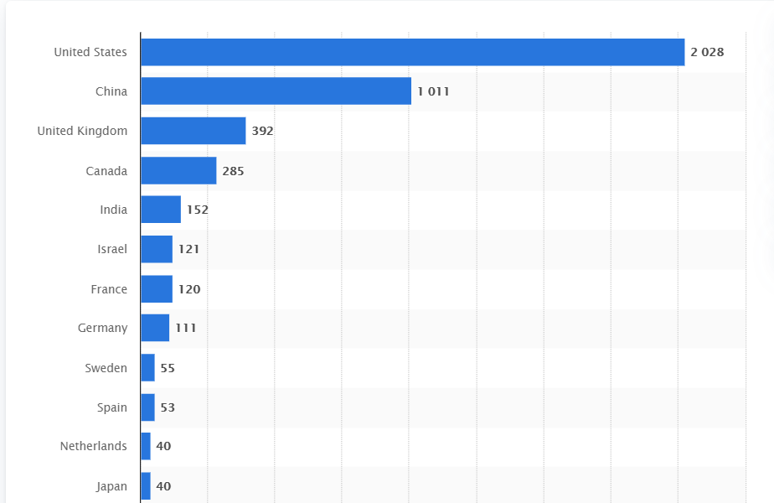
Artificial Intelligence

Slide 14
Artificial Intelligence

Slide 15
Similarities: Both cities are multicultural and diverse in their own ways and share a rich history of their own. Most of the famous neighbourhoods have a restaurant as its top most Common Venue. Differences: While looking at the maps one can observe that Paris is more compact and one can walk around much more freely without the use of transport In terms of population density Paris definitely outweighs London by a ratio of 4:1.
Results and Discussion

Slide 16
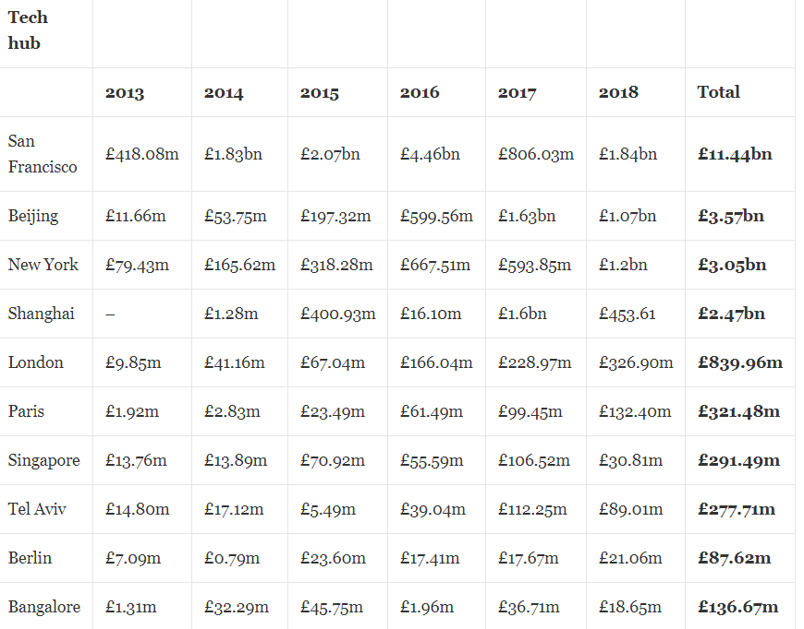
Artificial Intelligence
Results and Discussion

Slide 17
Artificial Intelligence The dataset for the Artificial Intelligence wasn't readily available and so had to be scrapped from multiple sources which often leads to inconsistency happening as well as errors. The districts have too complex geometry which would bring an error in our analysis if the venues are too close to each other. The data obtained through the API calls would return different results each time its called. Multiple trials and error runs are required to get the desired result.
Results and Discussion

Slide 18
Artificial Intelligence is a booming topic and recently more people have started investing into it as well as companies automating their processes Both cities offer a wide range of opportunities for anyone starting to invest in Artificial Intelligence or even start a company and various factors were shown. Finally a better model could be made by various other methods and much stronger Machine Learning Algorithms like KD Tree which have a much faster run time algorithm. Furthermore, clustering however did help us to highlight the most optimal venues and areas. Finally correlation does not imply causation and so any result here is subject to change on various other trends and opinions and datasets.
Conclusion

